Slide 1

Algorithm Analysis IT-2101
Dr. Mohammad Abu Yousuf
yousuf@juniv.edu

Slide 2
Single-Source Shortest Paths

Slide 3
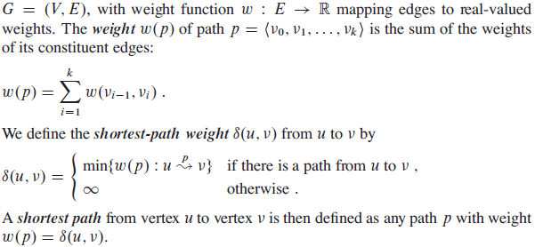
Single-Source Shortest Paths

Slide 4
Single-Source Shortest Paths
we shall focus on the single-source shortest-paths problem: given a graph G =(V, E), we want to find a shortest path from a given source vertex s ϵ V to each vertex v ϵ V .

Slide 5
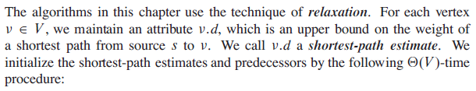
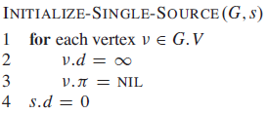
Single-Source Shortest Paths
Relaxation:
Here, each vertex v ϵ V a predecessor v.π that is either another vertex or NIL.

Slide 6

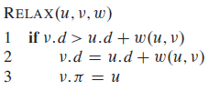
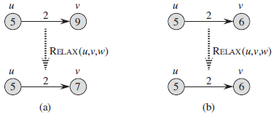
Single-Source Shortest Paths

Slide 7
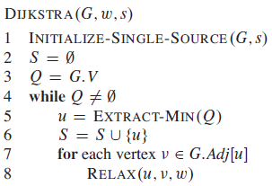
Single-Source Shortest Paths
Dijkstra’s algorithm:
Dijkstra’s algorithm solves the single-source shortest-paths problem on a weighted, directed graph G = (V,E) for the case in which all edge weights are nonnegative.

Slide 8
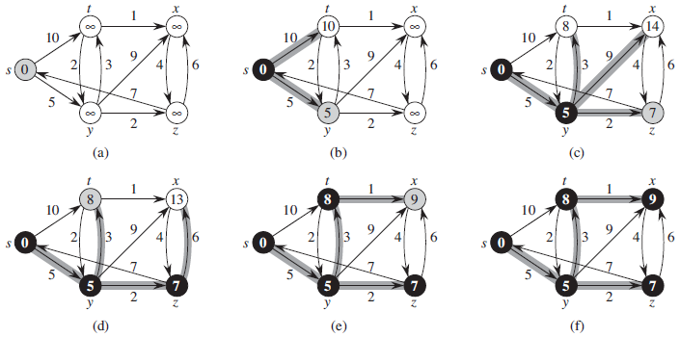
Dijkstra’s algorithm

Slide 9
Dijkstra’s algorithm:Example
u
v
∞
1
∞
10
9
2
3
s
0
4
6
5
7
∞
∞
2
x
y

Slide 10
Dijkstra’s algorithm: Example
u
v
10
1
∞
10
9
2
3
s
0
4
6
5
7
5
∞
2
x
y

Slide 11
Dijkstra’s algorithm:Example
u
v
8
1
14
10
9
2
3
s
0
4
6
5
7
5
7
2
x
y

Slide 12
Dijkstra’s algorithm: Example
u
v
8
1
13
10
9
2
3
s
0
4
6
5
7
5
7
2
x
y

Slide 13
Dijkstra’s algorithm:Example
u
v
8
1
9
10
9
2
3
s
0
4
6
5
7
5
7
2
x
y

Slide 14
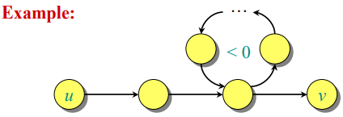
The Bellman-Ford algorithm
If a graph G = (V, E) contains a negative weight cycle, then some shortest paths may not exist.
Bellman-Ford algorithm: Finds all shortest-path lengths from a source s ∈ V to all v ∈ V or determines that a negative-weight cycle exists.

Slide 15
The Bellman-Ford algorithm
Bellman-Ford algorithm is designed for directed graphs.
If G is undirected, replace every edge (u,v) with two directed edges (u,v) and (v,u), both with weight w(u,v)

Slide 16
The Bellman-Ford algorithm
The Bellman-Ford algorithm solves the single-source shortest-paths problem in the general case in which edge weights may be negative.
Given a weighted, directed graph G =(V,E) with source s and weight w, the Bellman-Ford algorithm returns a boolean value indicating whether or not there is a negative-weight cycle that is reachable from the source.
If there is such a cycle, the algorithm indicates that no solution exists. If there is no such cycle, the algorithm produces the shortest paths and their weights.

Slide 17
The Bellman-Ford algorithm
The algorithm relaxes edges, progressively decreasing an estimate v.d on the weight of a shortest path from the source s to each vertex v until it achieves the actual shortest-path weight δ(s,v).
The algorithm returns TRUE if and only if the graph contains no negative-weight cycles that are reachable from the source.

Slide 18
The Bellman-Ford algorithm
BELLMAN-FORD(G,w,s)
INITIALIZE-SINGLE-SOURCE(G,s)
2. for i = 1 to |G.V|-1
3. for each edge (u,v) ∈ G.E
4. RELAX(u,v,w)
for each edge (u,v) ∈ G.E
if v.d > u.d + w(u,v)
7. return FALSE
8. return TRUE
INITIALIZE-SINGLE-SOURCE(G,s)
for each vertex v ∈ G.V
v.d = ∞
v.pi = NIL
s.d = 0
RELAX(u,v,w)
if v.d > u.d + w(u,v)
v.d = u.d + w(u,v)
v.pi = u
Step 2 to 4: Find shortest path
Step 5 to 7:Check negative weight cycle

Slide 19
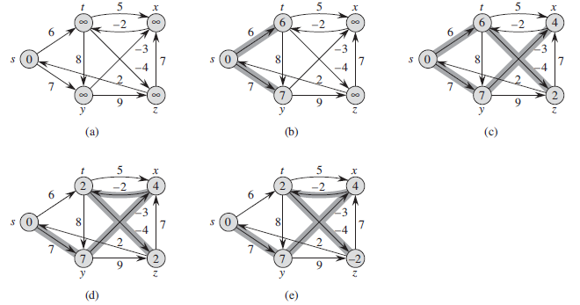
The Bellman-Ford algorithm

Slide 20
The Bellman-Ford algorithm
Bellman–Ford algorithm is slower than Dijkstra's Algorithm but it is capable of handling negative weights edges in the graph unlike Dijkstra's

Slide 21
Thank you

